Slide 1

** Document must be customized with your company specific information before use**

Slide 2
Workplace Safety Is Your Responsibility
This Pandemic Recovery Safety Policy template is intended for employers large and small.
MEMIC Loss Control makes no representation or warranty that any recommendation, report, action, statement, or other communication made by us or any of our service providers will assure that any practices, procedures, premises or operations are safe or healthful or in compliance with any law, rule or regulation.
Our resources and recommendations relate primarily to underwriting concerns and do not constitute an assumption or undertaking by us or our service providers of your obligations to provide a safe and healthful environment. Neither you nor your employees, agents, or invitees are entitled to rely upon any loss control activities provided by us and engaging in such activities is not a delegation to us of any of your legal responsibilities.
We exercise no control over your premises, operations, or employees, and have no responsibility or authority to implement loss control recommendations, the implementation of which is your sole responsibility. Maintaining a safe, healthful workplace in accordance with all applicable laws is your responsibility as a business owner.

Slide 3
Purpose of this Template
These training slides represent an outline for the general education and awareness of all employees regarding:
  the current pandemic threat (COVID19)**
  related workplace exposures
  steps your company is taking to reduce employee exposure
Where prompted, insert the pertinent part of your company’s policies and practices outlined on the slide
**It can also be used as an outline for training on the Pandemic Response section of an employer’s Emergency Response Plan
Notes:
https://www.osha.gov/Publications/OSHA3990.pdf
https://www.osha.gov/Publications/influenza_pandemic.html
https://www.osha.gov/Publications/OSHAFS-3747.pdf
From: https://www.osha.gov/SLTC/covid-19/controlprevention.html
Worker Training
Train all workers with reasonably anticipated occupational exposure to SARS-CoV-2 (as described in this document) about the sources of exposure to the virus, the hazards associated with that exposure, and appropriate workplace protocols in place to prevent or reduce the likelihood of exposure. Training should include information about how to isolate individuals with suspected or confirmed COVID-19 or other infectious diseases, and how to report possible cases. Training must be offered during scheduled work times and at no cost to the employee.
Workers required to use PPE must be trained. This training includes when to use PPE; what PPE is necessary; how to properly don (put on), use, and doff (take off) PPE; how to properly dispose of or disinfect, inspect for damage, and maintain PPE; and the limitations of PPE. Applicable standards include the PPE (29 CFR 1910.132), Eye and Face Protection (29 CFR 1910.133), Hand Protection (29 CFR 1910.138), and Respiratory Protection (29 CFR 1910.134) standards. The OSHA website offers a variety of training videos about respiratory protection.
When the potential exists for exposure to human blood, certain body fluids, or other potentially infectious materials, workers must receive the training required by the Bloodborne Pathogens (BBP) standard (29 CFR 1910.1030), including information about how to recognize tasks that may involve exposure and the methods, such as engineering controls, work practices, and PPE, to reduce exposure. Further information on OSHA's BBP training regulations and policies is available for employers and workers on the OSHA Bloodborne Pathogens and Needlestick Prevention Safety and Health Topics page.

Slide 4
Learning Objectives
Employees will:
  Understand what COVID-19 is, its symptoms, how it is spread, what to do if they feel symptoms
  Understand their responsibilities to reduce and prevent exposure as it applies to the current pandemic
  Know the Exposure Risk Level for their task/job/position
  Understand the hazard controls as they apply to their job
  Know the company-designated representative
Notes:
Part of creating good training is developing solid learning objectives or outcomes that guide the content.
The Objectives listed in the slide reflect the information contained in the training template. Customize the objectives to as needed.

Slide 5
Employee Responsibilities
<Insert employee responsibilities here>
Notes:
Restating the company’s expectations for its employees sets the stage for performance through the crisis.
All workers, including contractors and temporary workers, must understand their roles and responsibilities under the program
Employee responsibility recommendations:
All employees must:
Attend the required policy training session(s).
Adhere to the requirements of the policy.
Understand their Workplace Exposure Classification
Maintain appropriate physical distancing
Self Screen and submit to screening for COVID-19 symptoms prior to coming to work
Complete encounter tracking logs
Obtain and use PPE and sanitizing materials as required by the policy.
Provide feedback to management as to the effectiveness of the policy after implementation.

Slide 6
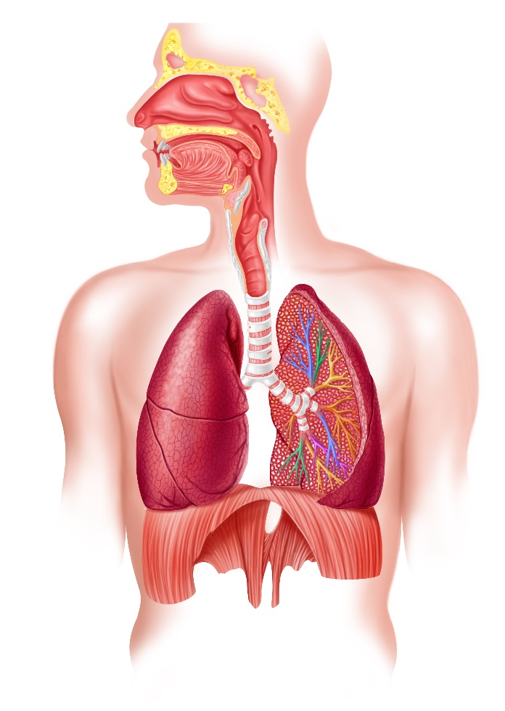
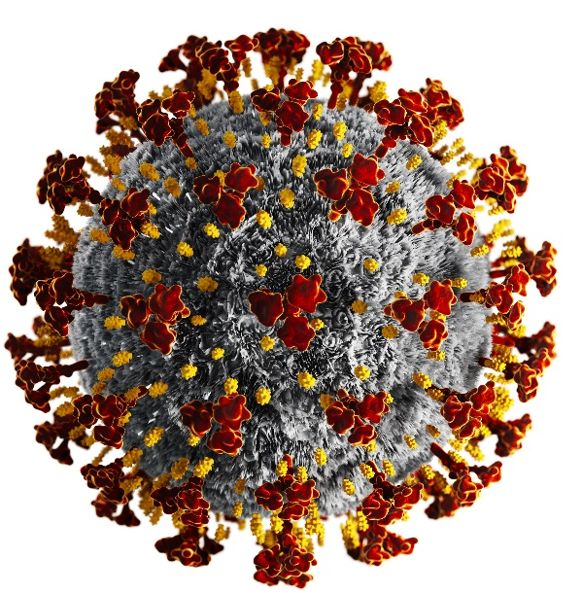
What is Coronavirus (COVID-19)?
There are many types of human coronaviruses including some that commonly cause mild upper-respiratory tract illnesses
COVID-19 is a new disease, caused by a novel (or new) coronavirus that has not previously been seen in humans
Notes:
https://www.cdc.gov/coronavirus/2019-ncov/faq.html#Coronavirus-Disease-2019-Basics

Slide 7
How COVID-19 is Spread?
Person-to-person transmission during close contact (within 6 feet):
Mainly via droplets of respiratory secretions produced when an infected person coughs, sneezes, or talks.
These droplets are believed to enter the mouths and noses of people nearby and can be inhaled into the nasal cavities and lungs.
There is also growing evidence of transmission risk from infected persons without symptoms or before the onset of recognized symptoms.
Notes:
According to the CDC
https://www.cdc.gov/coronavirus/2019-ncov/prevent-getting-sick/how-covid-spreads.html
https://www.cdc.gov/coronavirus/2019-ncov/faq.html#How-COVID-19-Spreads

Slide 8



How COVID-19 is Spread?
Touching contaminated surfaces or objects, and then touching your mouth, nose, or possibly eyes
Notes:
https://www.cdc.gov/coronavirus/2019-ncov/faq.html#How-COVID-19-Spreads

Slide 9
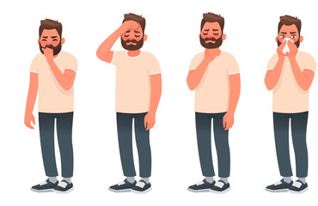
What are the Symptoms of COVID-19?
Mild to severe respiratory illness
Two or more symptoms may present
Symptoms may appear 2-14 days after exposure
Cough
Shortness of breath or difficulty breathing
Fever
Chills
Repeated shaking with chills
Muscle pain
Headache
Sore throat
New loss of taste or smell
Notes:
https://www.cdc.gov/coronavirus/2019-ncov/symptoms-testing/symptoms.html

Slide 10
Who is Likely at Higher Risk?
Older adults – people 65 years and older
People who live in nursing homes or long-term care facilities
Those with underlying medical conditions:
  Chronic lung disease, or moderate to severe asthma
  Serious heart conditions
  Compromised immune systems from cancer treatments, smoking, etc.
  Sever obesity
  Diabetes
  Chronic kidney disease undergoing dialysis
  Liver disease
Notes:
https://www.cdc.gov/coronavirus/2019-ncov/need-extra-precautions/people-at-higher-risk.html

Slide 11

When Should You Isolate / Stay Home?
Employees will not be allowed to work and must be quarantined for 14 days if they have:
  Reported testing positive for COVID-19
  Reported contact with a person who tested positive
  Reported symptoms without testing positive
WORK
STAY HOME
Notes:
https://www.cdc.gov/coronavirus/2019-ncov/community/guidance-business-response.html

Slide 12
Reporting Symptoms:
Employees shall not come to, or be allowed to remain at, work or the job site if sick or symptomatic (with fever, cough, and/or shortness of breath)
No symptomatic or COVID-19 positive workers are allowed on site
Worker(s) who have contact with a worker or any other person who is diagnosed with COVID-19 are required to self quarantine for 14 days
Notes:
https://www.cdc.gov/coronavirus/2019-ncov/hcp/disposition-in-home-patients.html

Slide 13
Reporting Symptoms:
Employees must report the following to <COMPANY DESIGNATED REP NAME AND CONTACT INFO> :
    Testing positive for COVID-19
    Coming in contact with a person who tested positive for COVID-19
    Feeling symptoms without testing positive for COVID-19
<Insert policy for returning to work after reporting symptoms of contact with someone with COVID 19>
Notes:
https://www.cdc.gov/coronavirus/2019-ncov/hcp/disposition-in-home-patients.html

Slide 14
Employee benefits
Sick leave policies are flexible and consistent with public health guidance
  <COMPANY> sick leave policy is:
Employees who are sick with acute respiratory illness, will NOT have to get healthcare provider’s note to validate their illness or to return to work.
  Our policy for return to work is:
If you need time to care for a sick family member our policy is:
Notes:
The purpose of this slide is to help remove barriers for employees so they don’t feel compelled to come to work while sick. Provide information to employees about the benefits available to them if they are sick.
Suggestions:
Sick leave policies are flexible and consistent with public health guidance
<COMPANY> sick leave policy is:
Employees who are sick with acute respiratory illness, will NOT have to get healthcare provider’s note to validate their illness or to return to work.
If you need time to care for a sick family member our policy is:

Slide 15
Employee benefits
Insert Health Care Benefits regarding COVID-19:
Insert Work Related Injury Reporting Policy regarding COVID-19:
Insert Unemployment regarding COVID-19:
Contact <COMPANY HR> for additional information regarding employee benefits related to pandemics.
Notes:
The purpose of this slide is to help remove barriers for people so they don’t feel compelled to come to work while sick. Provide information to employees about the benefits available to them if they are sick.

Slide 16
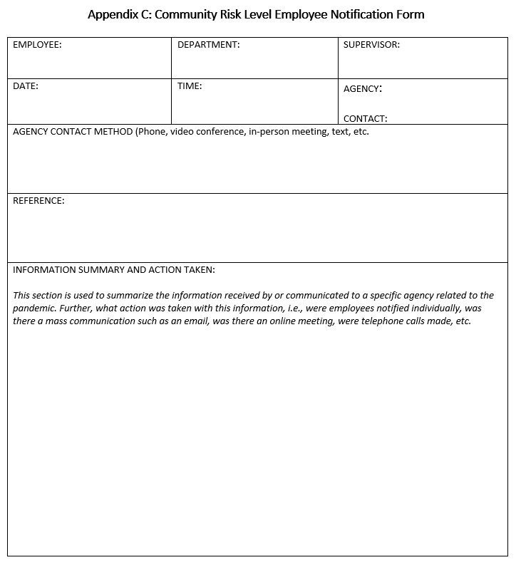
Employee Messaging
Employees must have a clear message about their risk at work
The community risk level informs your company’s initial and ongoing response
Notes:
This message will help clear up the misunderstandings and
provide a reliable source for employees to gather information
connects the dots about the risk in community, the risk at work, and controls necessary

Slide 17
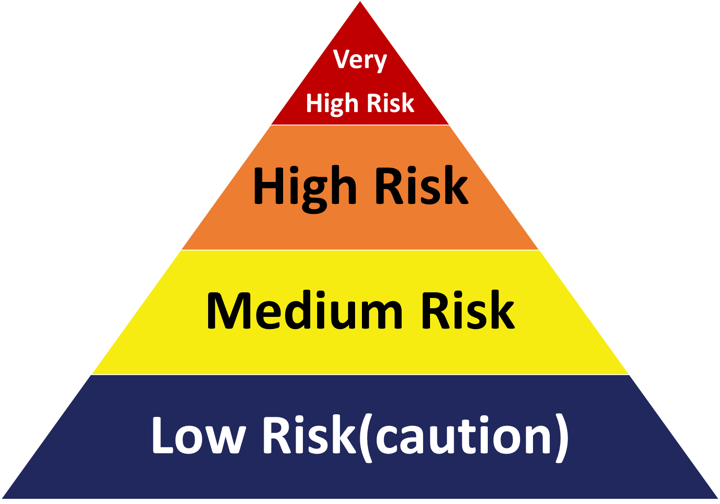
Exposure Risk Level
Occupational Risk Pyramid for COVID-19
  OSHA Level categories
    Very High - high potential for exposure to known or suspected sources of COVID-19 during specific medical, postmortem, or laboratory procedures.
    High - high potential for exposure to known or suspected sources of COVID-19, such as Healthcare delivery and support staff, medical transport worker (when moving known or expected COVID-19 patients)
    Medium - require frequent and/or close contact with (i.e., within 6 feet of) people who may be infected with SARS-CoV-2, but who are not known or suspected COVID-19 patients.
    Low - do not require contact with people known to be, or suspected of being, infected with SARS-CoV-2 nor frequent close contact with (i.e., within 6 feet of) the general public.
Notes:
Helping workers understand their overall exposure provides a framework for implementing appropriate controls.
https://www.osha.gov/Publications/OSHA3990.pdf
https://www.osha.gov/SLTC/covid-19/hazardrecognition.html

Slide 18
Work Exposure Risk Level
<COMPANY’S> Jobs and Corresponding Exposure Risk Levels are:
Follow are Examples from OSHA Control and Prevention of COVID 19 | Risk Level (Low, Med, High, Very High)
Performing administrative duties in non-public areas of work sites, away from other workers. | LOW
Working in stock rooms or other non-public areas of stores, away from customers and other workers. | LOW
Working when the facility is closed to the public, such as overnight, performing tasks, such as stocking shelves, away from other workers. | LOW
Working in high-volume retail environments, including at points of sale and other positions within such facilities. | Medium
Notes:
https://www.osha.gov/SLTC/covid-19/hazardrecognition.html
https://www.osha.gov/SLTC/covid-19/controlprevention.html

Slide 19
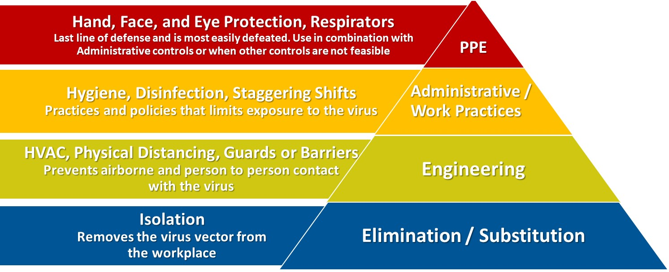
How to prioritize our controls?
Use this Preferred Approach
Least Effective
Most Effective
Notes:
From: https://www.osha.gov/SLTC/covid-19/controlprevention.html
As discussed on the Hazard Recognition page explains, workers’ job duties affect their level of occupational risk. Employers should assess the hazards to which their workers may be exposed; evaluate the risk of exposure; and, select, implement, and ensure workers use controls to prevent exposure. Control measures may include a combination of engineering and administrative controls, safe work practices, and PPE.
PPE = Personal Protective Equipment
Worker infection prevention recommendations are based on an approach known as the hierarchy of controls.
This approach groups actions by their effectiveness in reducing or removing hazards.
In most cases, the preferred approach is to eliminate a hazard or processes; install engineering controls; and implement appropriate cleaning, sanitation, and disinfection practices to reduce exposure or shield workers. Administrative controls are also an important part of an approach to prevention in these workplaces.

Slide 20
Remote Work
The following positions are required to work remotely:
To request help setting up your remote workstation contact:
  <COMPANY DESIGNATED REP NAME AND CONTACT INFO>
Notes:
Remote Work
Evaluate options for working remotely or in an alternate location and utilizing your flexible leave policy for when an employee is sick

Slide 21
Engineering Controls
List/Discuss engineering controls that have been put in place:
For more information about engineering controls contact:
  <COMPANY DESIGNATED REP NAME AND CONTACT INFO>
Notes:
Engineering Controls
https://www.cdc.gov/niosh/engcontrols/default.html
Examples:
Engineering controls protect workers by removing hazardous conditions or by placing a barrier between the worker and the hazard. Examples include local exhaust ventilation to capture and remove airborne emissions or machine guards to shield the worker.
Install physical barriers, such as clear plastic sneeze guards.
References from OSHA for more information:
Healthcare
Dentistry
Emergency response and public safety
Postmortem care
Manufacturing (developed in partnership with CDC)
Meat and poultry processing (developed in partnership with CDC)
Laboratories
Airline operations
Retail operations
Border protection and transportation security
Correctional facility operations
Solid waste and wastewater management
Environmental (i.e., janitorial) services
In-home repair services
Business travelers
Travel to areas where the virus is spreading

Slide 22
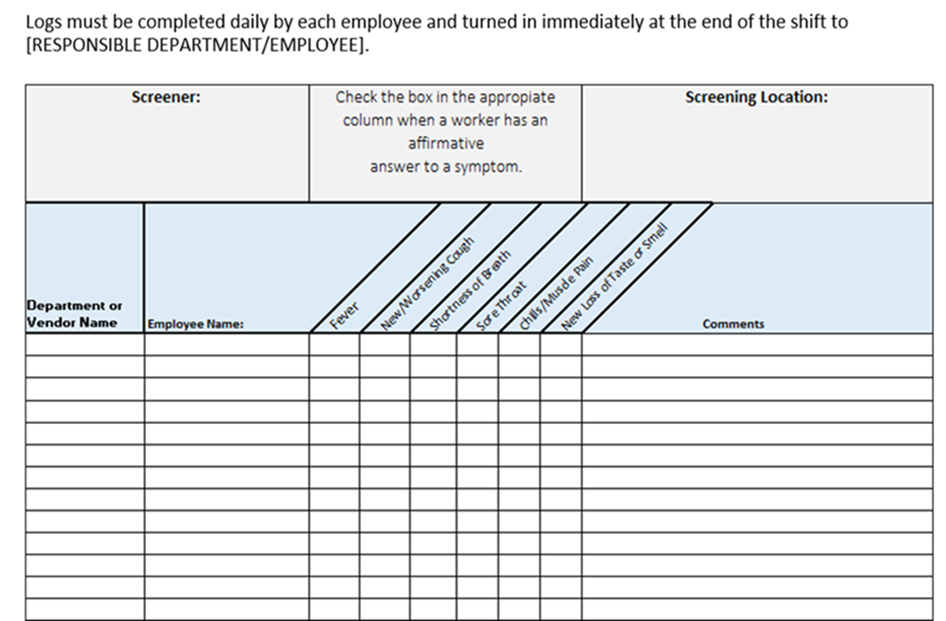
Employee Screening:
<Insert policy for At Home Self Screening and Pre-Facility Entry Screening>
Notes:
Example:
To the extent feasible, prior to the commencement of each work shift
a pre-screening or survey shall verify that each employee for that shift has no symptoms of respiratory illness (fever, cough, and/or shortness of breath), including temperature checks (required based on State and Local).
https://www.shrm.org/resourcesandtools/tools-and-samples/hr-forms/pages/memo-covid-19-employee-screening-procedures.aspx
https://www.shrm.org/resourcesandtools/tools-and-samples/hr-forms/pages/covid-19-employee-health-screening-form.aspx
https://www.cdc.gov/coronavirus/2019-ncov/community/guidance-business-response.html

Slide 23
Physical Distancing
Insert <COMPANY> Physical Distancing policy here
Notes:
Physical Distancing – suggestions
All employees must observe strict social distancing of 6 feet while on the job and should refrain from touching their faces.
No congregation of employees is allowed.
All common areas, such as break rooms and cafeterias, but excluding restrooms, are closed.
No more than 2 people shall occupy one vehicle when conducting work
Face coverings will be worn when appropriate physical distancing cannot be maintained
Additional details will be provided by your supervisor when you review your Job Hazard Analysis
https://www.cdc.gov/coronavirus/2019-ncov/prevent-getting-sick/social-distancing.html
https://www.cdc.gov/phlp/publications/social_distancing.html

Slide 24
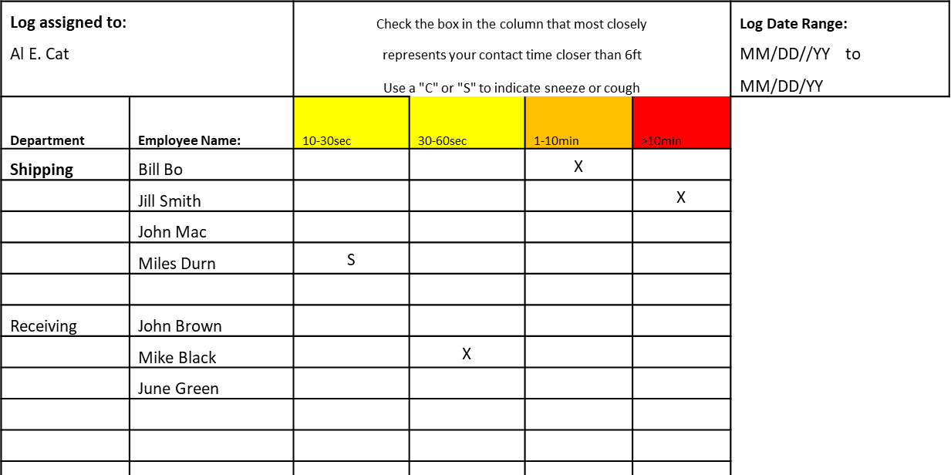
Contact or Encounter Tracking
<Insert Policy regarding contact tracing>
Tracking forms will be submitted to <NAME/TITLE>.
Notes:
Example:
During epidemic/pandemic events, employees with identified work-related exposure to other workers, external customers, and/or the public will complete (at a frequency to be determined by <COMPANY>) an encounter tracking log.
Reference the Encounter Tracking/Contract Tracing section in the MEMIC Pandemic Recovery Safety Plan
Encounter/Contact tracking helps the employer understand where employees come inside the social/physical distancing prescriptions and can be helpful to determine who may have been exposed if there is a positive case at the facility.
Reference MEMIC Safety Experts Podcast – Social Distancing with Kevin Roche - https://www.memic.com/podcast#social-distancing-kevin-roche

Slide 25
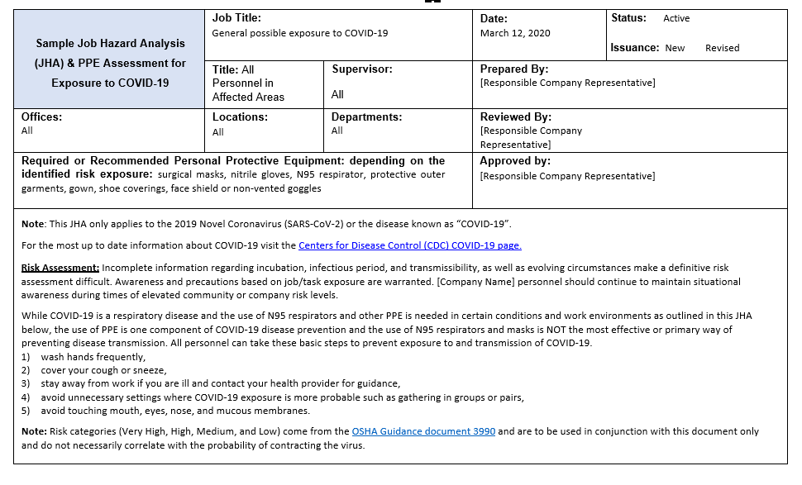

Job Hazard Analysis Changes
Notes:
Review any JHA changes related to CODVI-19 exposure and controls in the workplace
https://www.osha.gov/Publications/OSHA3990.pdf

Slide 26
Hygiene
The virus is thought to spread mainly from person-to-person:
  Through inhalation of respiratory droplets form an infected person and
  Through cross contamination of surfaces
<Insert policy around Hand Hygiene here>
Notes:
Example:
Employees will have easy and frequent access to soap and clean running water and hand sanitizer during duration of work
Handwashing or hand sanitization is required before entering, and leaving, job sites.
Employees will be provided with these additional tools to assist with hand hygiene:
Beyond bathroom facilities additional handwashing and sanitizing stations are located:
Other company provided supplies or tools
https://www.cdc.gov/coronavirus/2019-ncov/community/organizations/businesses-employers.html
https://www.cdc.gov/coronavirus/2019-ncov/prevent-getting-sick/prevention.html

Slide 27
Hand Washing and Sanitization
For washing, follow these five steps every time:
  Wet your hands with clean, running water (warm or cold), turn off the tap, and apply soap.
  Lather your hands completely with the soap.
  Scrub your hands for at least 20 seconds.
  Rinse your hands well under clean, running water.
  Dry your hands using a clean towel or air dry them.
Use hand sanitizer when you can’t use soap and water
Notes:
https://www.cdc.gov/coronavirus/2019-ncov/hcp/hand-hygiene.html
https://www.cdc.gov/healthywater/hygiene/hand/handwashing.html

Slide 28
Hand Washing and Sanitization
Use hand sanitizer when you can’t use soap and water
For hand sanitizer:
  Apply the gel product to the palm of one hand (read the label to learn the correct amount).
  Rub your hands together.
  Rub the gel over all the surfaces of your hands and fingers until your hands are dry. This should take around 20 seconds.
Notes:
https://www.cdc.gov/coronavirus/2019-ncov/hcp/hand-hygiene.html
https://www.cdc.gov/healthywater/hygiene/hand/handwashing.html

Slide 29
General Hygiene
Follow good cough/sneeze etiquette
  Cover your mouth and nose with a tissue when you cough or sneeze
  Throw used tissues in the trash
  If you don’t have a tissue, cough or sneeze into your elbow, not your hands
Avoid touching the eyes, nose, or mouth with unwashed hands.
Avoid close contact with people who are sick.
Notes:
https://www.cdc.gov/healthywater/hygiene/etiquette/coughing_sneezing.html

Slide 30
Cleaning and Disinfection
All common spaces and equipment, including bathrooms, hi-touch surfaces, tools and equipment, and vehicles must be cleaned and disinfected between shifts and prior to transfer from one person to another.
<Insert new practices around cleaning and disinfecting>
Notes:
https://www.cdc.gov/coronavirus/2019-ncov/community/clean-disinfect/index.html
https://www.cdc.gov/coronavirus/2019-ncov/community/guidance-business-response.html

Slide 31
Personal Protective Equipment (PPE)
PPE is a last resort and must be used only when other forms of control are unable to fully protection the employee from exposure to the hazard.
Insert list of jobs/tasks with required PPE:
Job/Task/Position – Examples from OSHA Control and Prevention of COVID 19 | Risk Level (Low, Med, High, Very High) | Required PPE
Performing administrative duties in non-public areas of work sites, away from other workers. | LOW | None
Working in stock rooms or other non-public areas of stores, away from customers and other workers. | LOW | None
Working when the facility is closed to the public, such as overnight, performing tasks, such as stocking shelves, away from other workers. | LOW | None
Working in high-volume retail environments, including at points of sale and other positions within such facilities. | Medium | Gloves
PPE is selected based on the hazard assessment and workers specific job duties.
Notes:
PPE is a last resort and must be used only when other forms of control are unable to fully protection the employee from exposure to the hazard.
PPE specific to COVID-19 is can include: (this is not a complete list)
Gloves - Nitryl or vinyl gloves are used to protect against pathogenic hazards
Eye and Face protection – Glasses w/side shields, goggles, faces shields
Respirators vs masks – know the difference and how they are applied
A face mask (also called a surgical mask, procedure mask, or other similar terms) on a patient or other sick person should not be confused with PPE for a worker; the mask acts to contain potentially infectious respiratory secretions at the source (i.e., the person’s nose and mouth).

Slide 32
Proper Use of PPE
Review/Demonstrate proper use of PPE:
  How to put it on and take it off without cross contamination
  Proper use and limitations
  How to fit it correctly
  How to inspect it
    Serviceable condition
    What to do if it doesn’t meet standards
  How to dispose of it if contaminated
  Maintenance if it is not disposable
    Laundering/Cleaning/Disinfection
    Storage
Notes:
https://www.osha.gov/SLTC/covid-19/controlprevention.html
When eye protection is needed, use goggles or face shields. Personal eyeglasses are not considered adequate eye protection.
After removing PPE, always wash hands with soap and water for at least 20 seconds, if available. Ensure that hand hygiene facilities (e.g., sink or alcohol-based hand rub) are readily available at the point of use (e.g., at or adjacent to the PPE removal area).
Employers should establish, and ensure workers follow, standard operating procedures for cleaning (including laundering) PPE and items such as uniforms or laboratory coats intended to function as PPE, as well as for maintaining, storing, and disposing of PPE. When PPE is contaminated with human blood, body fluids, or other potentially infectious materials, employers must follow applicable requirements of the Bloodborne Pathogens standard (29 CFR 1910.1030) with respect to laundering.

Slide 33
Face Coverings and Respirators
<Insert company policy on use of face coverings and respirators>
    <THIS REQUIRMENT MUST BE INLINE WITH LOCAL, STATE, AND FEDERAL GUIDANCE>
Notes:
https://www.cdc.gov/coronavirus/2019-ncov/prevent-getting-sick/diy-cloth-face-coverings.html
https://www.cdc.gov/coronavirus/2019-ncov/prevent-getting-sick/cloth-face-cover.html
https://www.cdc.gov/coronavirus/2019-ncov/prevent-getting-sick/cloth-face-cover-faq.html
Face Coverings are not respirators
Employee must wear face coverings over their nose and mouth when there is the potential to be closer than 6ft from others.
In the case of retail cashiers, a translucent shield or “sneeze guard” is acceptable in lieu of a mask.
Face coverings will be worn when appropriate physical distancing cannot be maintained
<THIS REQUIRMENT MAY CHANGE WITH LOCAL, STATE, AND FEDERAL GUIDANCE>
Respirators
Tight fitting and are considered personal protective equipment.
If N95 masks are used voluntarily, there is no need to have fit test conducted (but need to provide mandatory Appendix D)
If respirators are required in a workplace (such as for workers in the Very High Risk Exposure category),
they must be used in the context of a comprehensive respiratory protection program that meets the requirements of OSHA's Respiratory Protection standard (1910.134)
Respirators must be used if involved in medical procedures when exposed to aerosolized virus (intubating, treatment of coughing, etc.)

Slide 34
Jobs/Tasks that Require Respirators
List the tasks at your company where respirators are required because of the current pandemic threat:
Notes:
Use the OSHA Controls and Prevention Page - https://www.osha.gov/SLTC/covid-19/controlprevention.html for more information

Slide 35
Additional Requirements for Traveling Workers
Prior to traveling to visit a customer, the customer’s Workplace Exposure Risk Classification must be determined:
  <COMPANY> process
For Very High and High exposures control plan is in place and approved by direct supervisor/management.
  Insert <COMPANY> plan to manage exposures
Notes:
https://www.cdc.gov/coronavirus/2019-ncov/community/guidance-business-response.html
https://www.cdc.gov/coronavirus/2019-ncov/community/critical-workers/implementing-safety-practices.html
General Control can include:
Customers assessed as having Medium exposure risk can be visited with the following customer controls in place:
Customer Controls
Ensure that adequate meeting room is available to allow appropriate physical distancing before during and after the meeting.
Potential meeting members exhibiting viral symptoms will be prevented from attending the meeting to prevent possible infection of others.
Limit the number of printed documents distributed to prevent possible infection of others
Other controls - <Insert additional controls as appropriate>
Affected employees may conduct virtual meetings with customers and vendors whenever feasible, appropriate, and warranted.
Limit the number of printed documents distributed to prevent possible infection of others
Face coverings????
Practice good hand hygiene frequently
Practice good respiratory etiquette
Avoid touching your eyes, nose, or mouth with unwashed hands.
Maintain appropriate physical distancing
Employers and workers in operations where there is no specific exposure hazard should remain aware of the evolving community transmission. Changes in community transmission may warrant additional precautions in some workplaces or for some workers
See CDC for more guidance: https://www.cdc.gov/coronavirus/2019-ncov/community/guidance-business-response.html
Low Risk Exposure
Are jobs that do not require contact with people known to be, or suspected of being, infected with SARS-CoV-2 nor frequent close contact with (i.e., within 6 feet of) the general public.
Workers in this category have minimal occupational contact with the public and other coworkers.
Medium Risk Classification
Are jobs that require frequent and/or close contact with (i.e., within 6 feet of) people who may be infected with SARS-CoV-2, but who are not known or suspected COVID-19 patients.
In areas without ongoing community transmission, workers in this risk group may have frequent contact with travelers who may return from international locations with widespread COVID-19 transmission.
In areas where there is ongoing community transmission, workers in this category may have contact with the general public (e.g., schools, high-population-density work environments, some high-volume retail settings).

Slide 36
Questions
Please contact <COMPANY Designate Representative> or any company manager with questions.

Slide 37
References
CDC Return to Work for Healthcare
CDC Return To Work
CDC Interim Guidance for Employers
CDC Guidance for Travelers inside USA
CDC Coronavirus Prevention
CDC List of State and Local Health Departments
CDC Critical Workers Implementing Safety Practices
CDC Business Response Guidance
CDC Risk Assessment Guidance
OSHA COVID-19 Background
OSHA Return to Work
AIHA Coronavirus Outbreak Resource Center
OSHA Protecting Workers During a Pandemic
OSHA Guidance on Preparing Workplaces for COVID-19

